Slide 1






Coins Detection and counting

Slide 2


Introduction
In this project, we develop a machine learning system designed to detect and accurately count coins. Our goal is to enhance efficiency, reduce errors, and streamline financial processes.

Slide 3

Challenge
Developing a ML system for detecting and counting coins is a crucial step in enhancing the efficiency of financial and administrative processes. This system is needed to achieve greater accuracy, increase work speed, and reduce human errors. Counting coins manually is highly important but faces several challenges, such as variations in coin sizes and shapes, complexities arising from similar-looking coins.

Slide 4





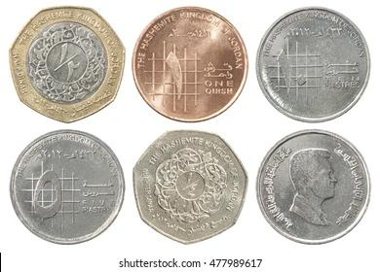
Data collection
capturing images using a camera or mobile device.
images from the internet

Slide 5

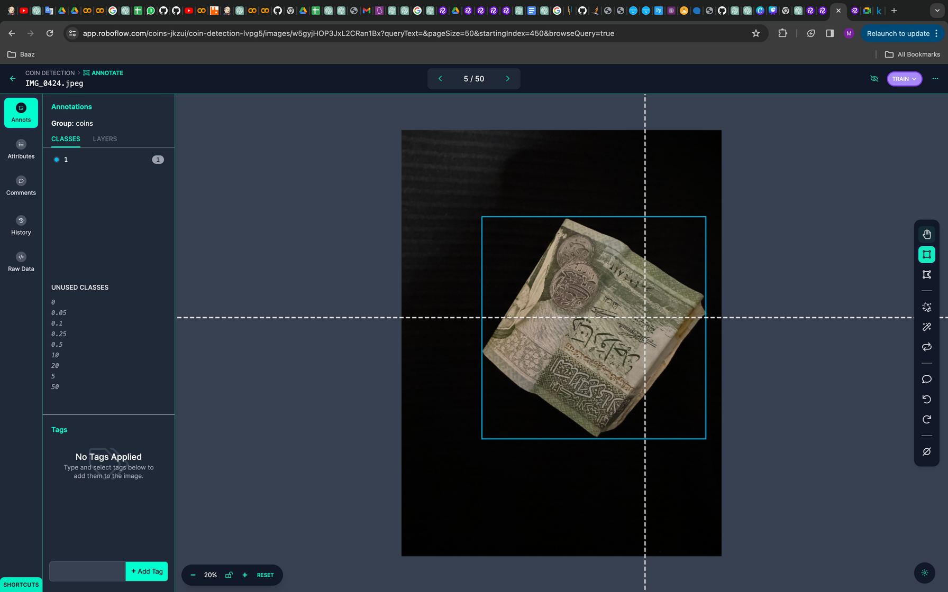
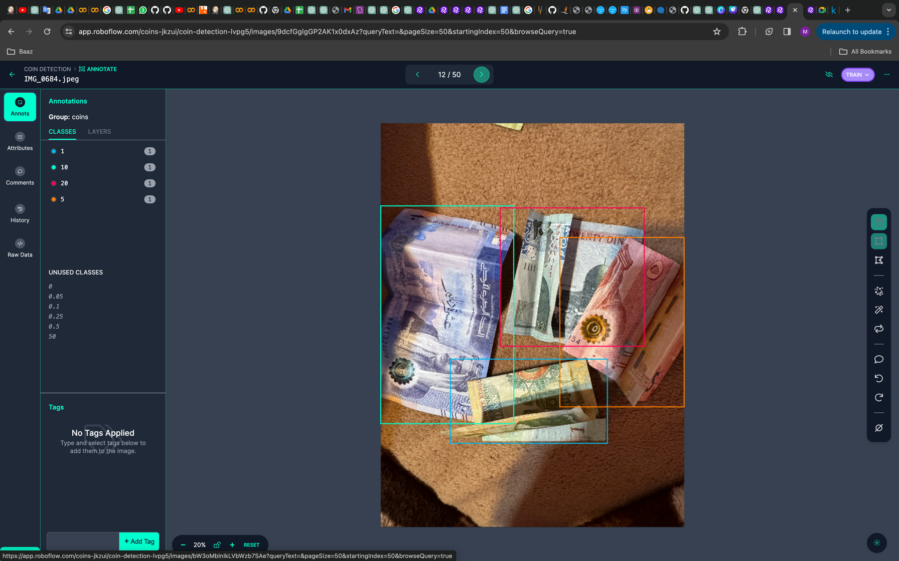
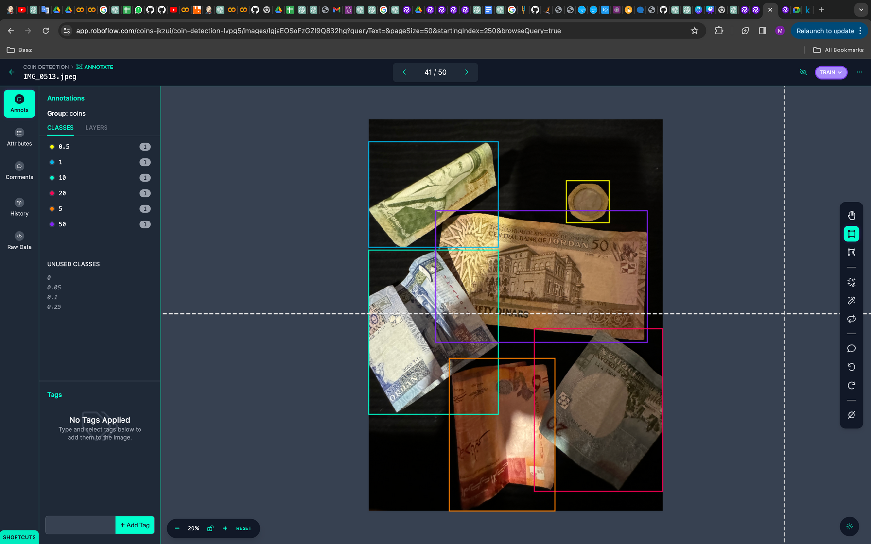




Data Annotation
Bounding boxes

Slide 6
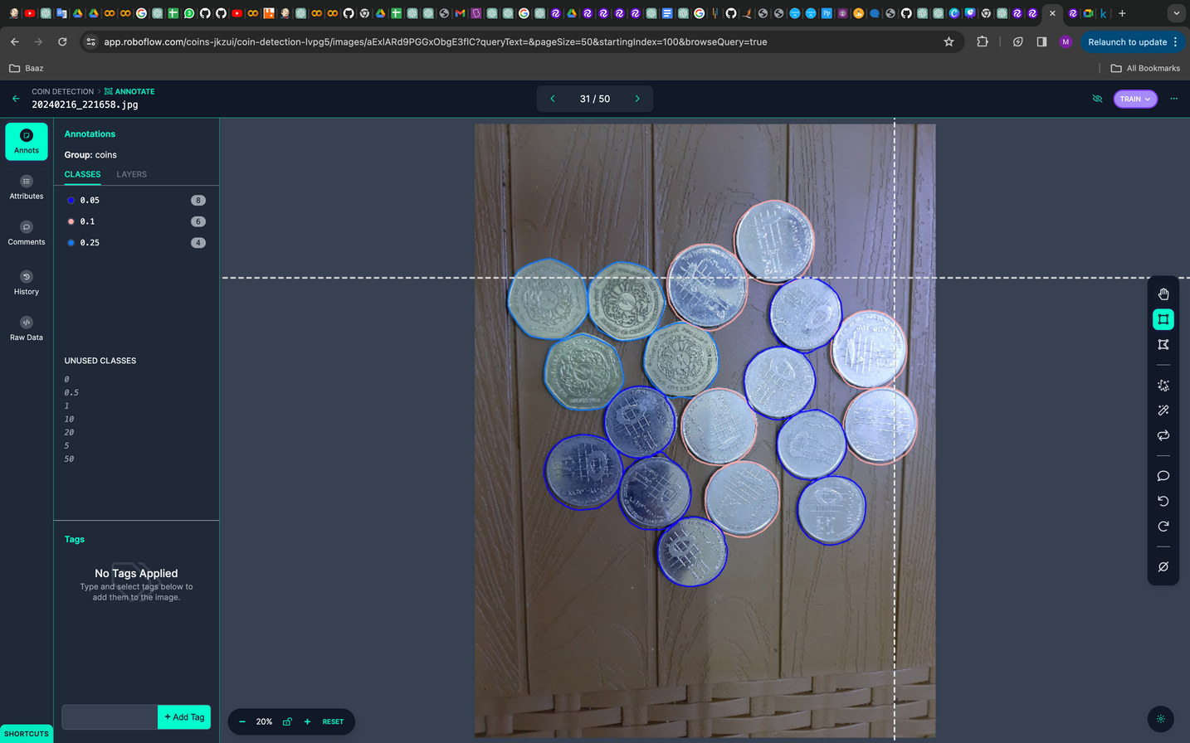
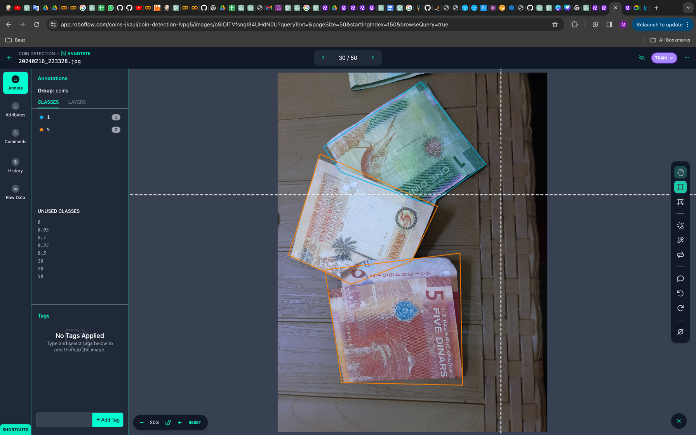
Data Annotation
Polygons

Slide 7
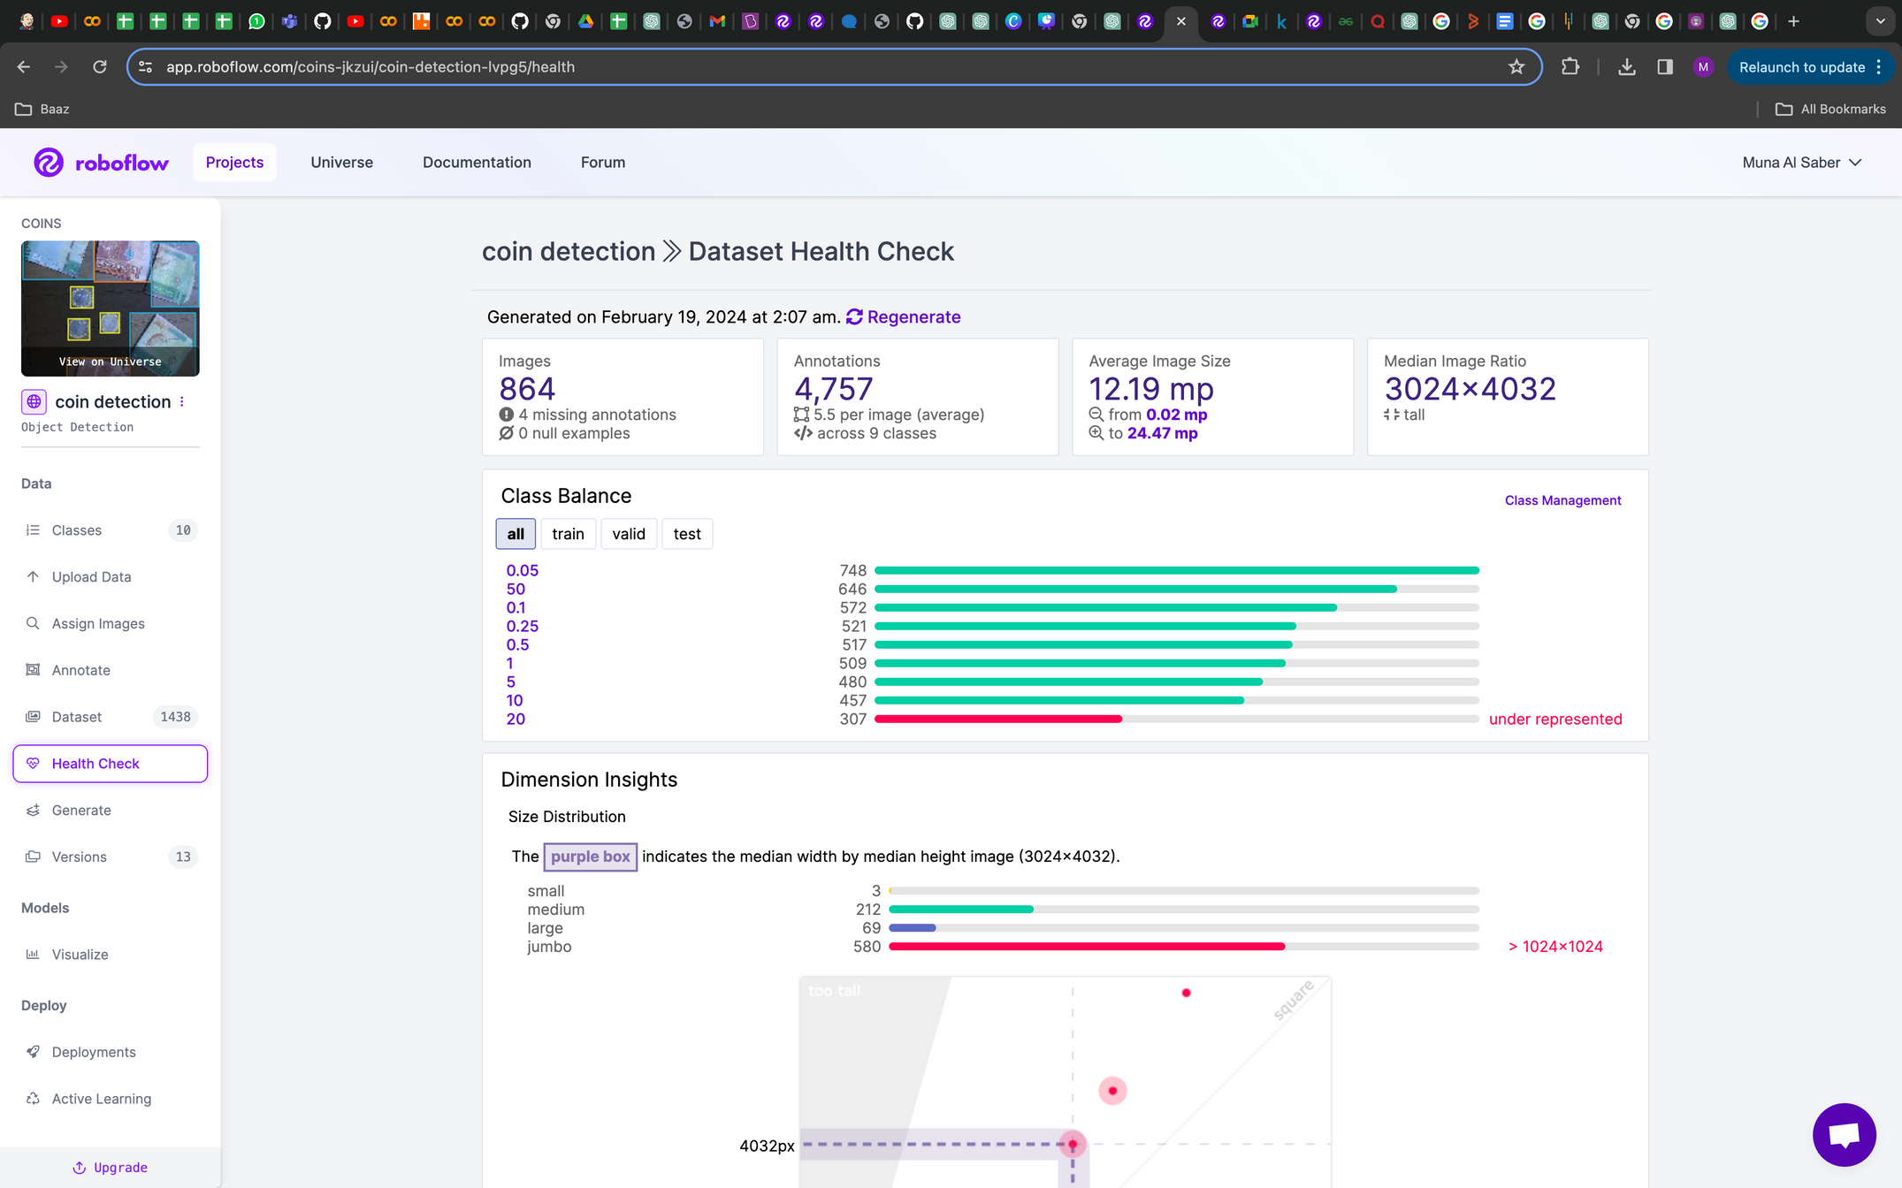
Dataset Health Check

Slide 8


Data Preprocessing

Slide 9

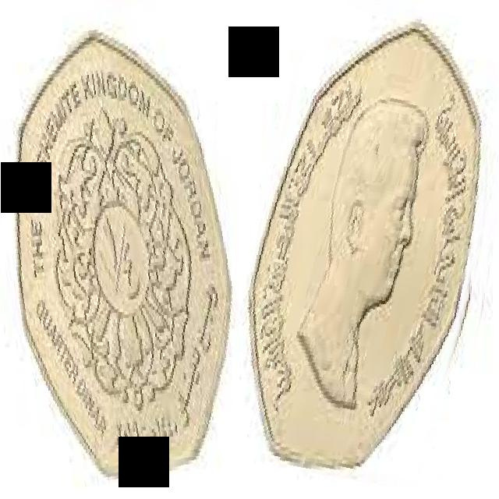

Data augmentation
Samples of Dataset after augmentation

Slide 10
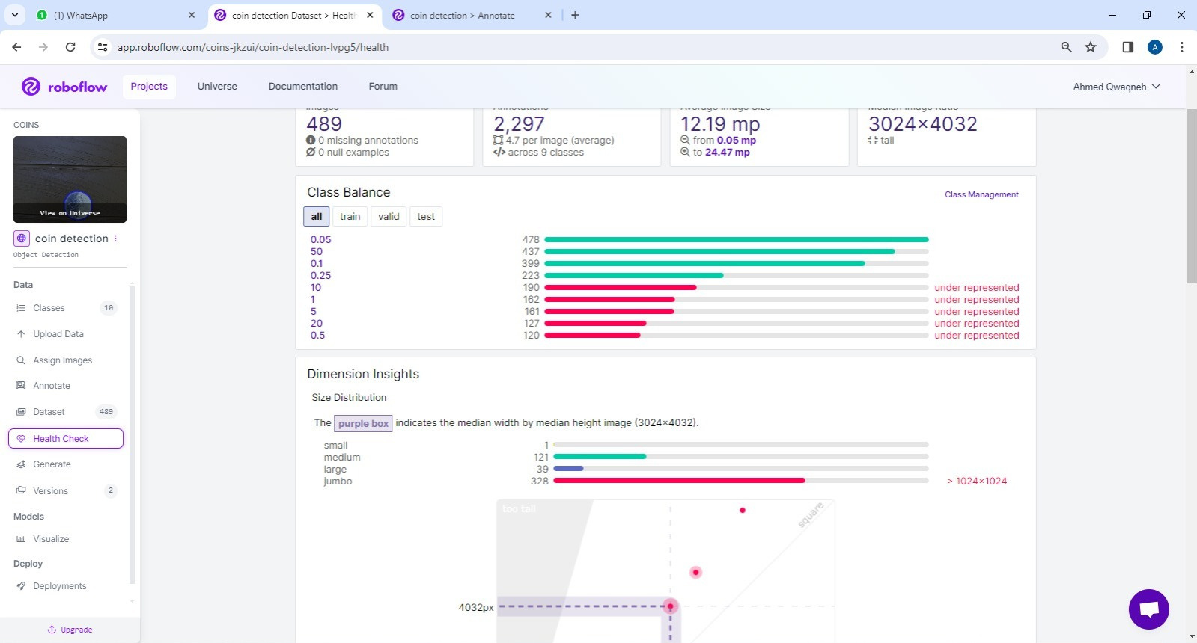

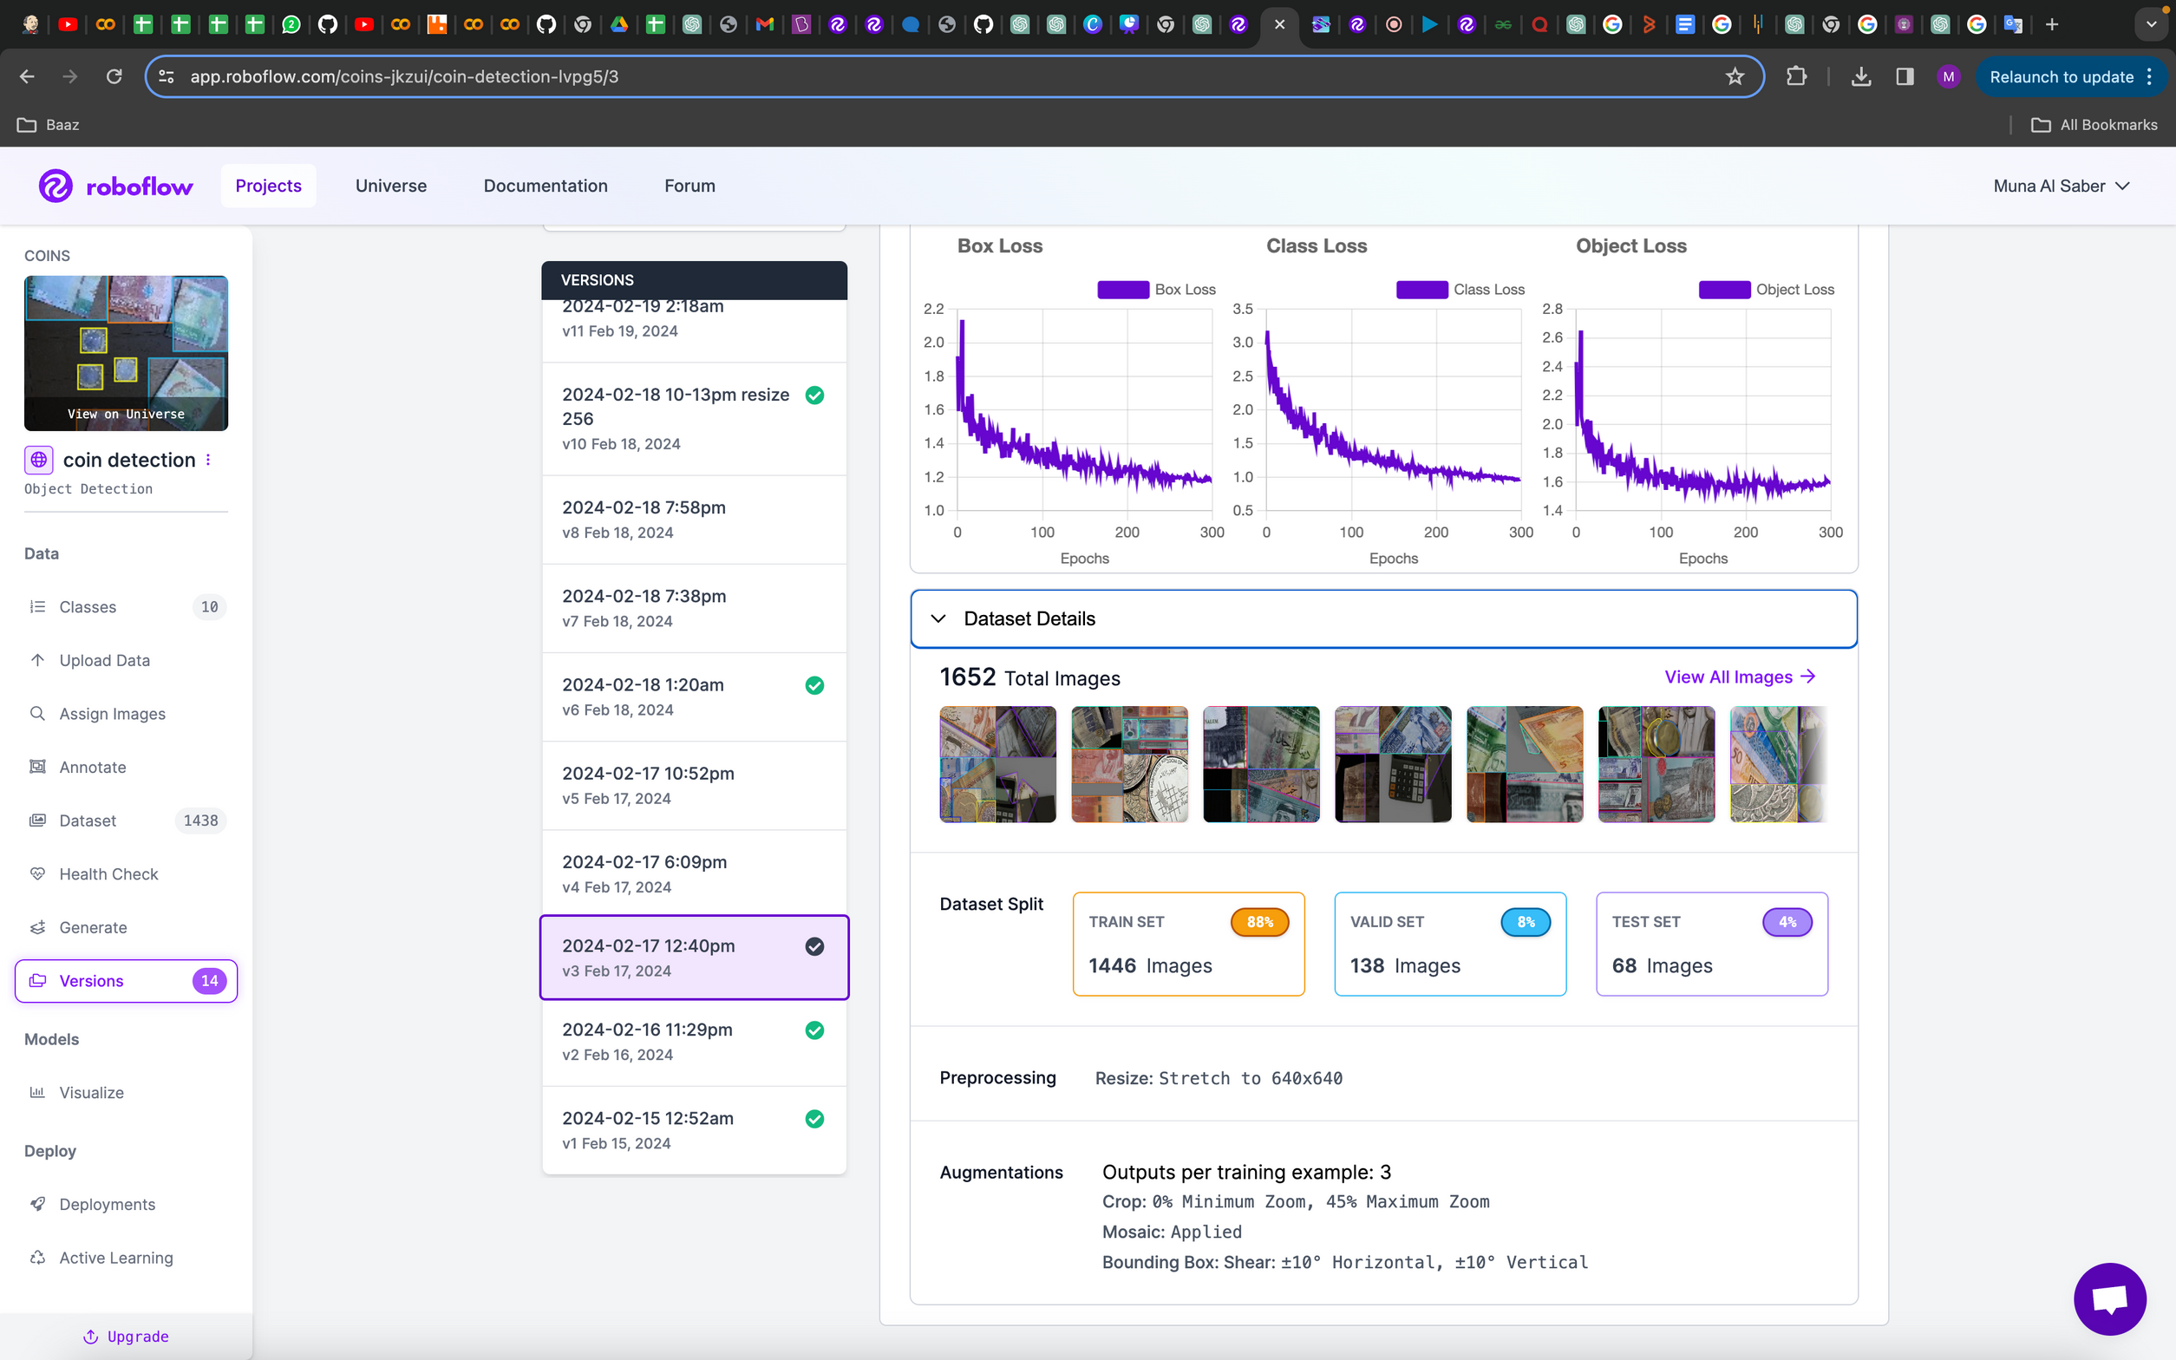
Modeling
Yolov8
V3
Mixed annotation
small dataset

Slide 11
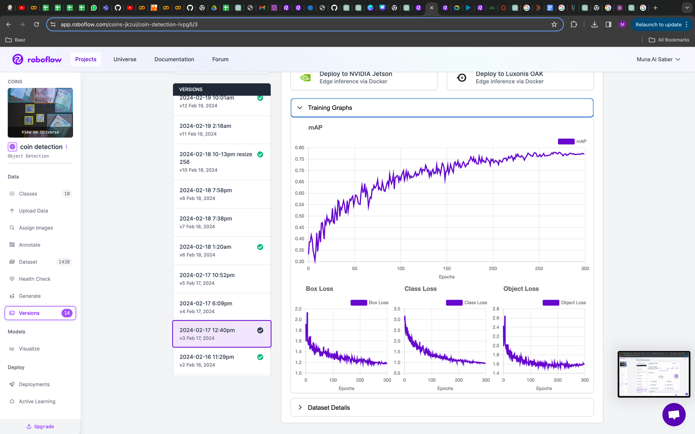
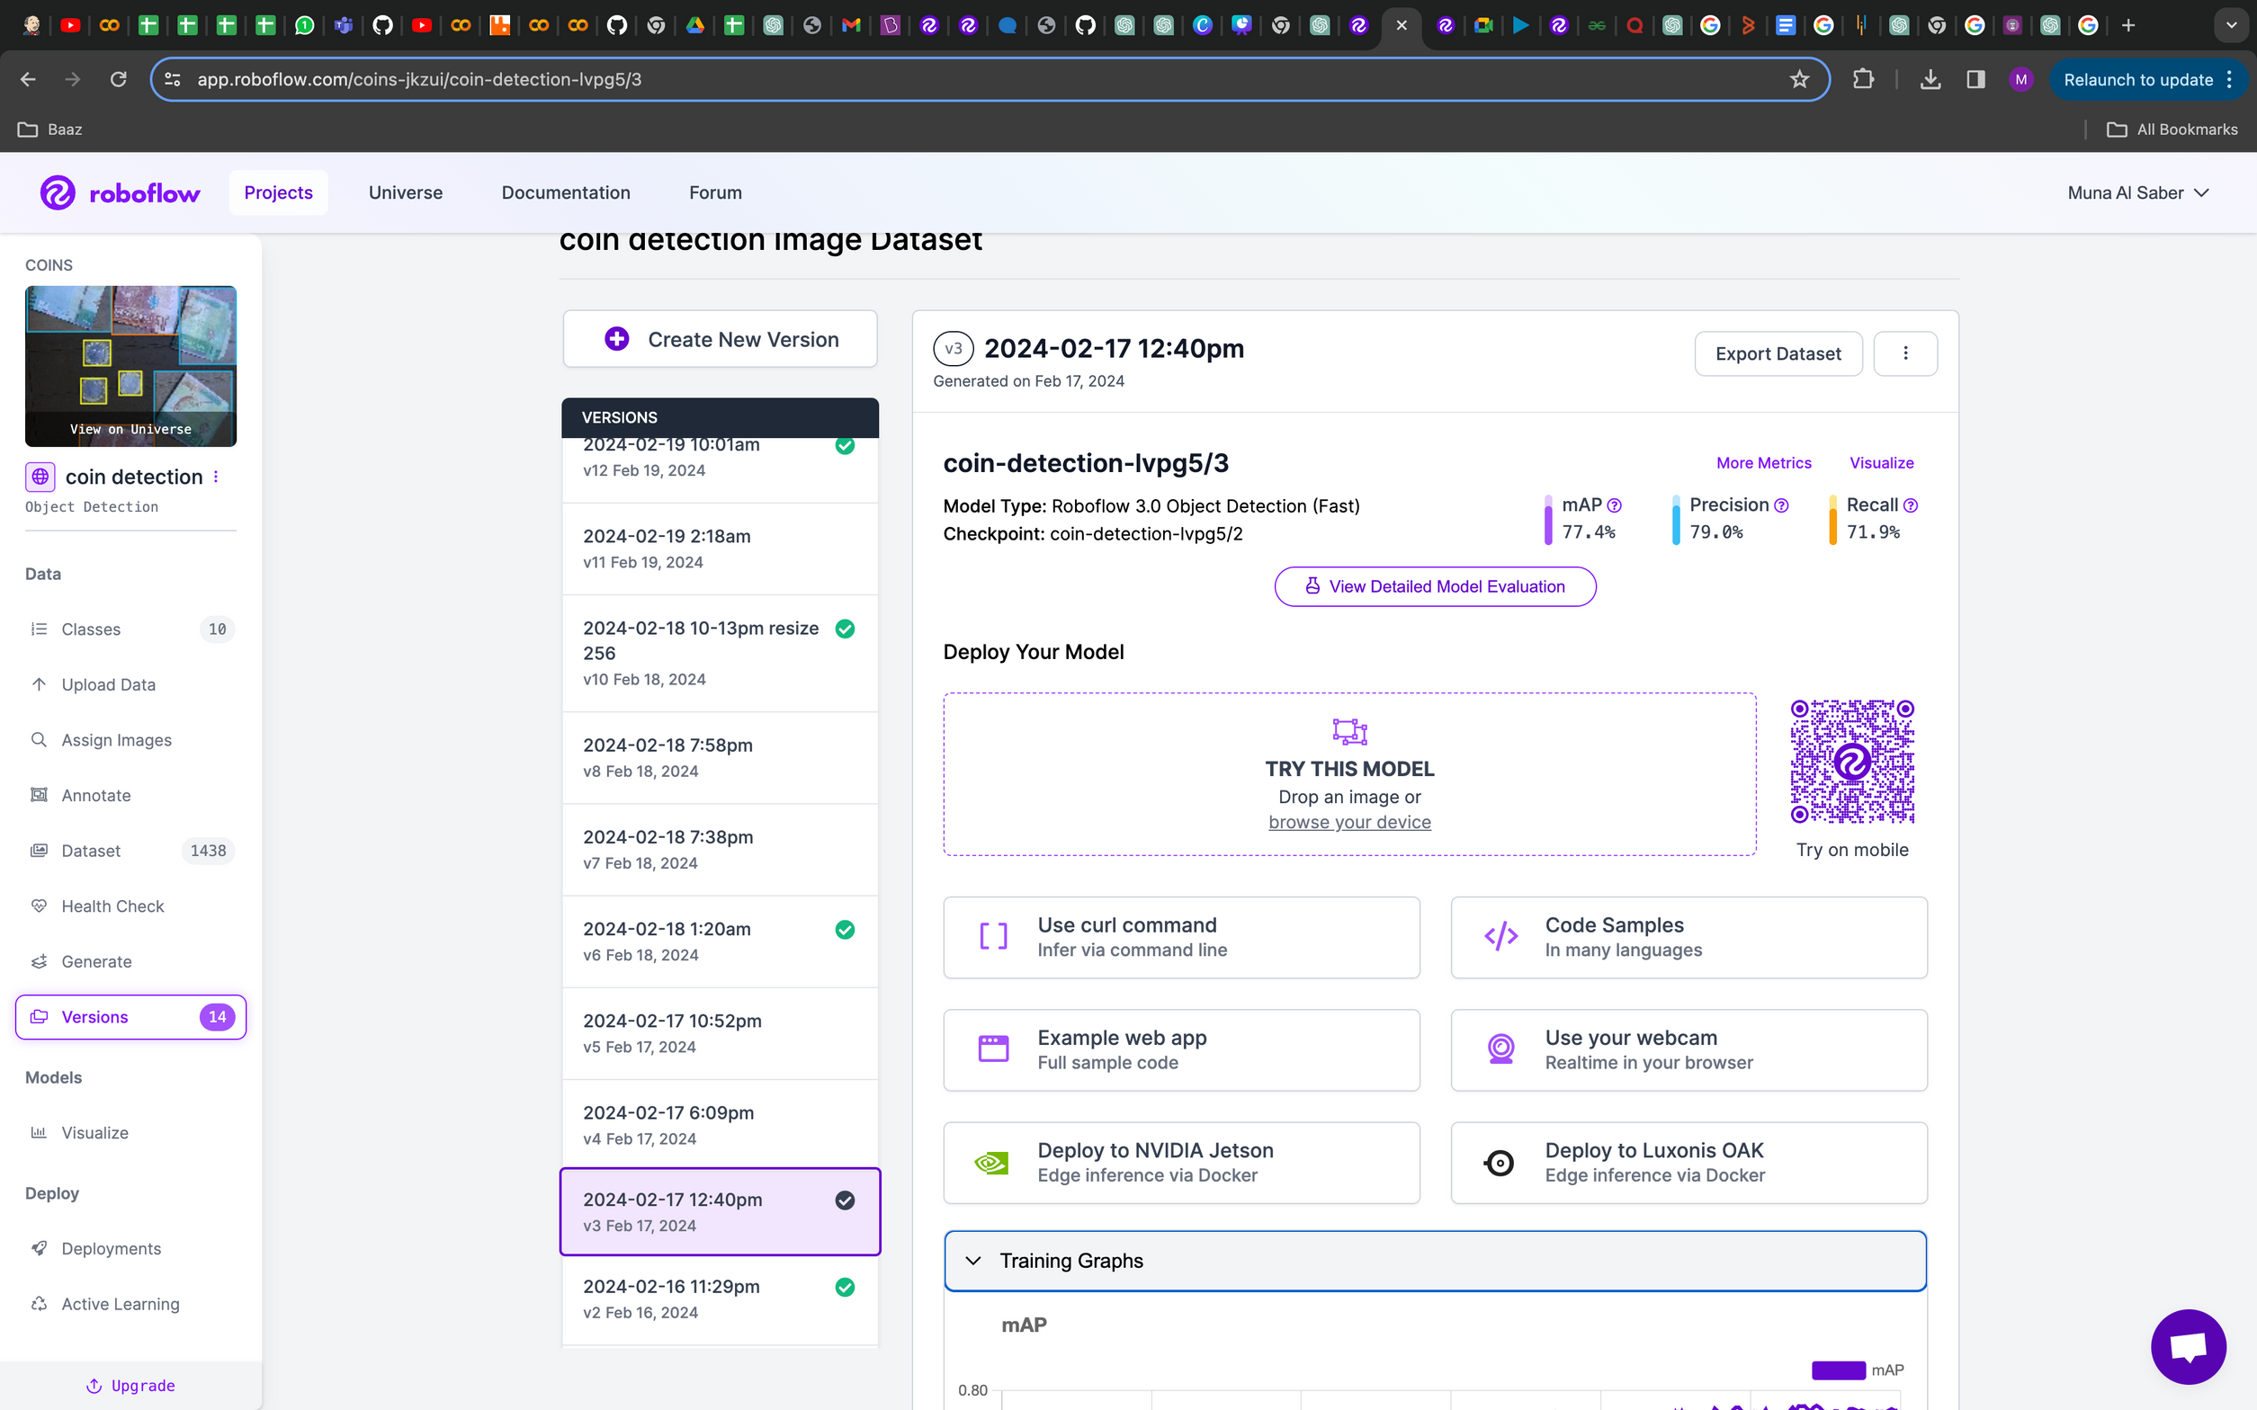
Modeling
V3

Slide 12
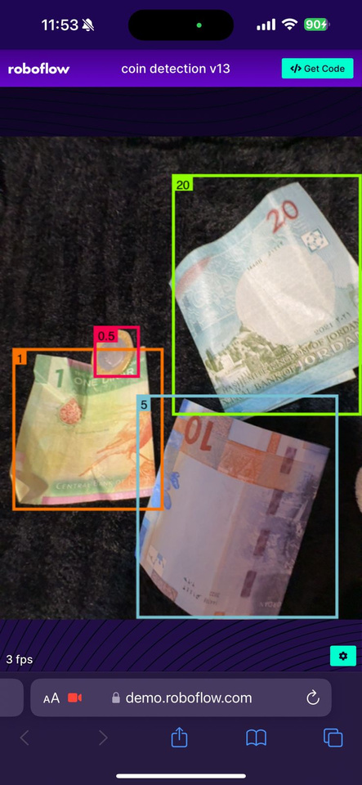
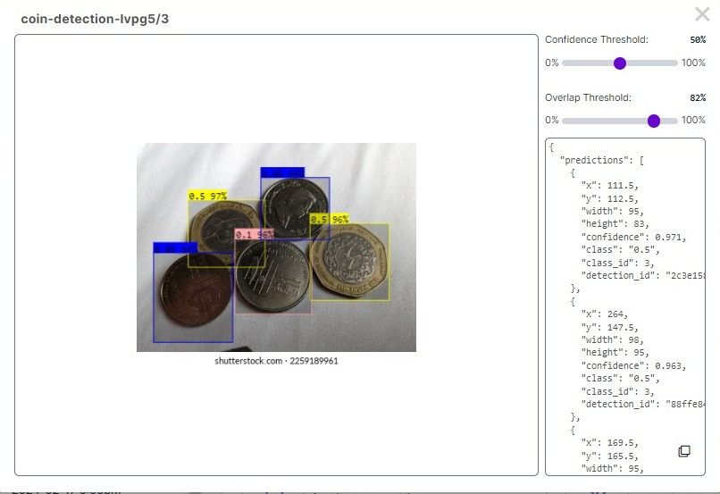

Modeling
V3

Slide 13
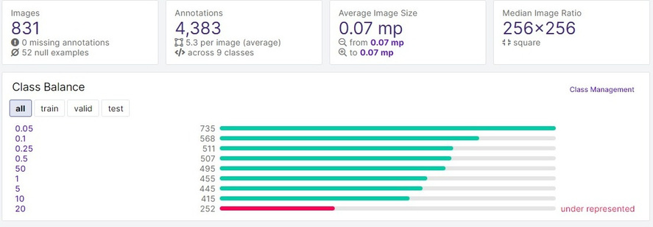
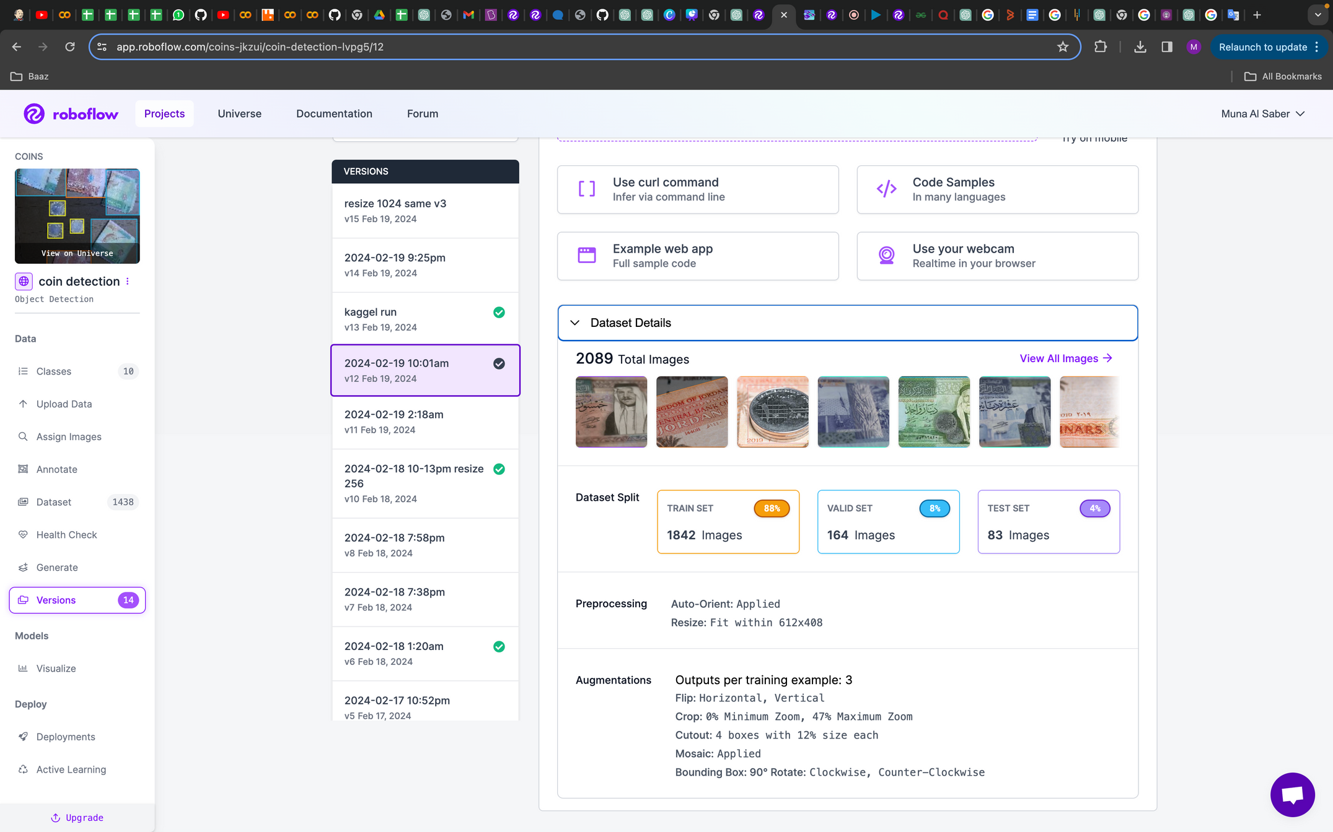
Modeling
V12
only bounding boxes
more dataset

Slide 14
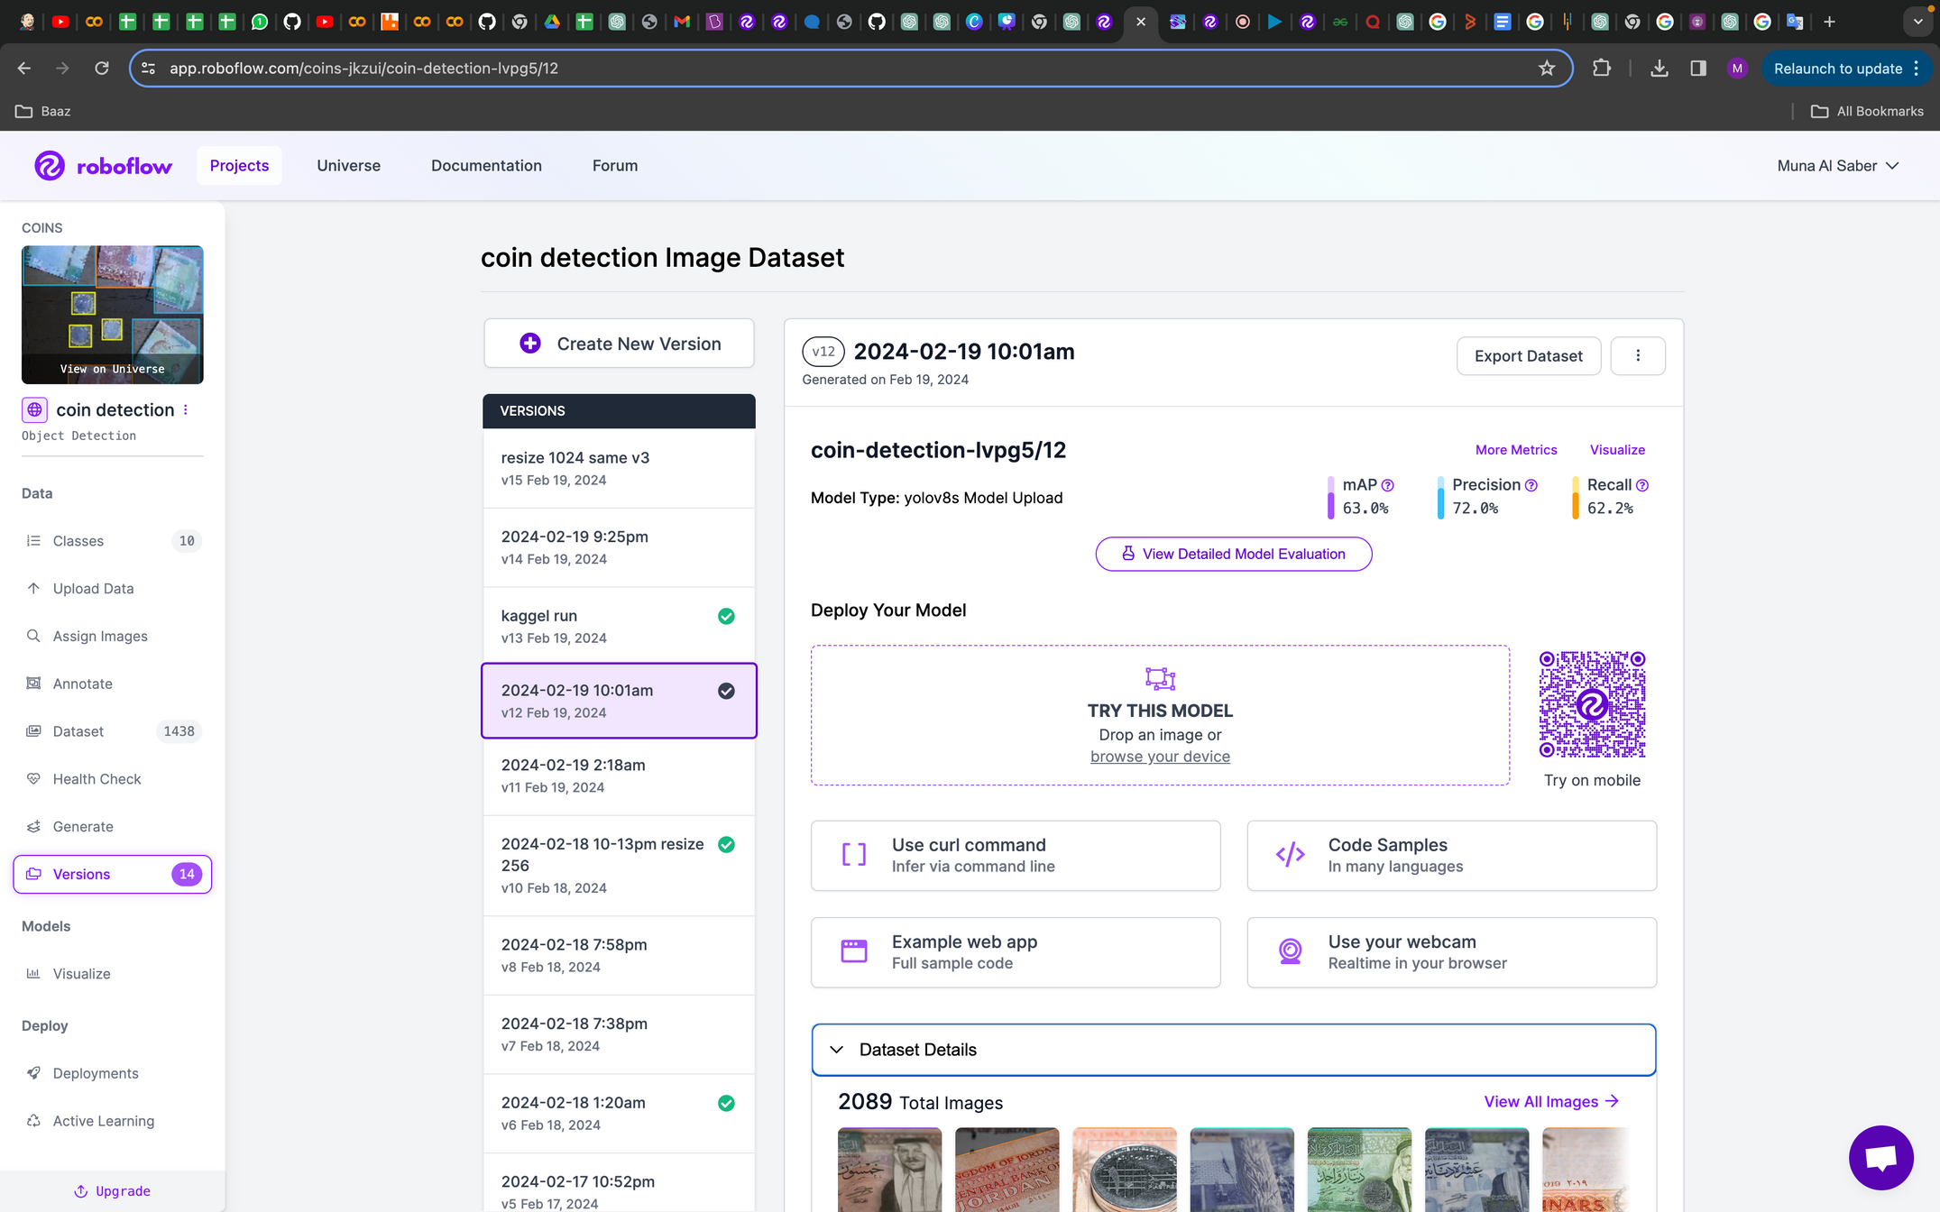
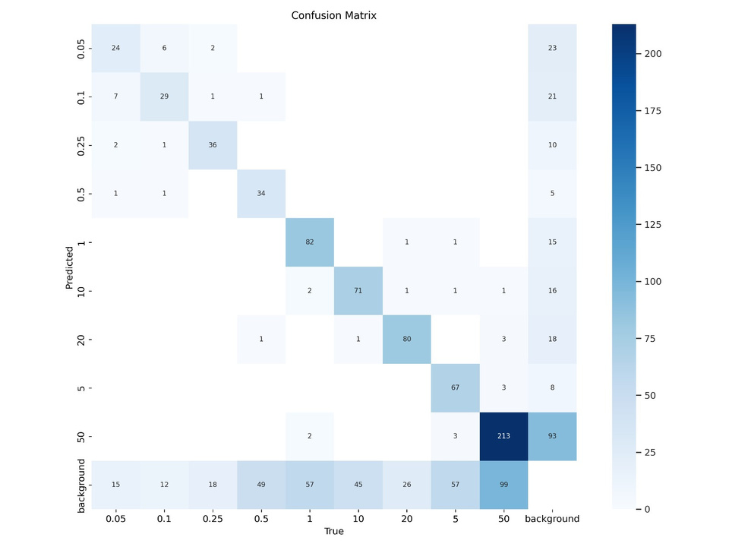
Modeling
V12

Slide 15
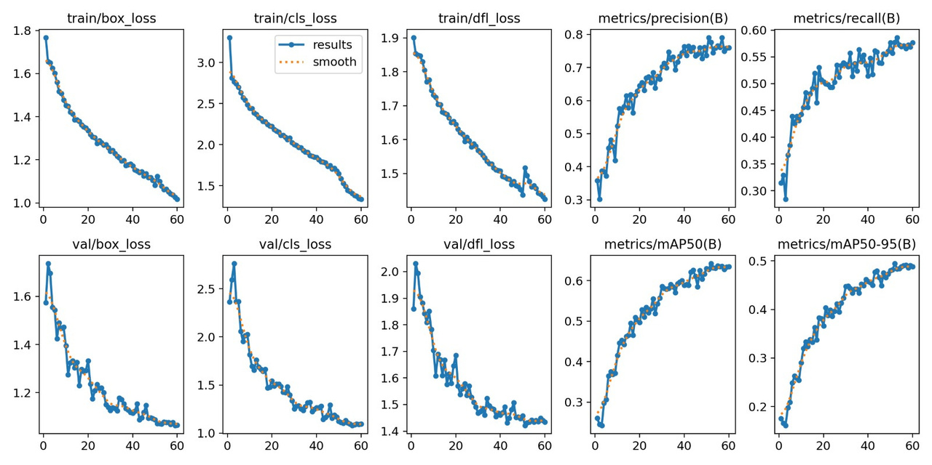
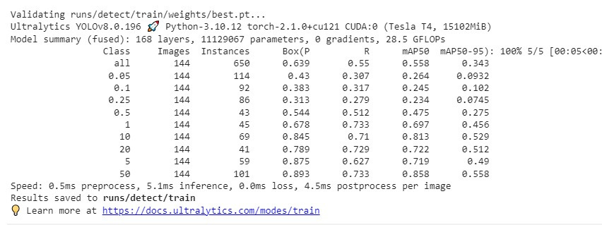
Modeling
V12

Slide 16
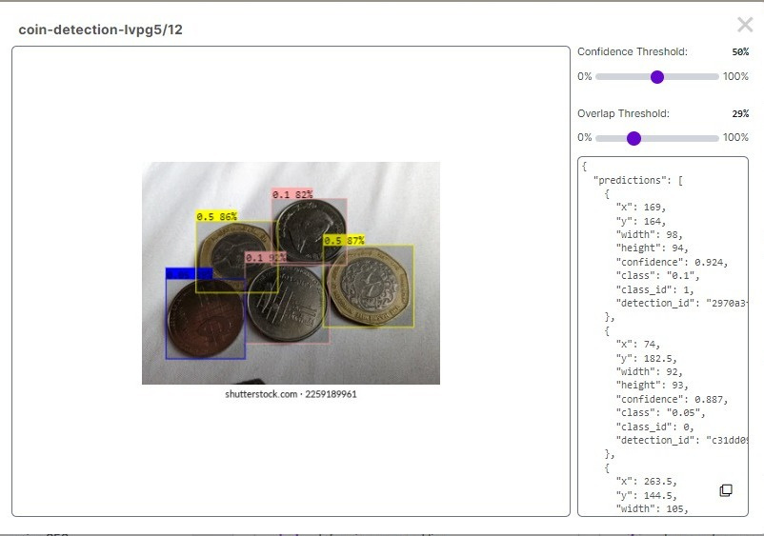
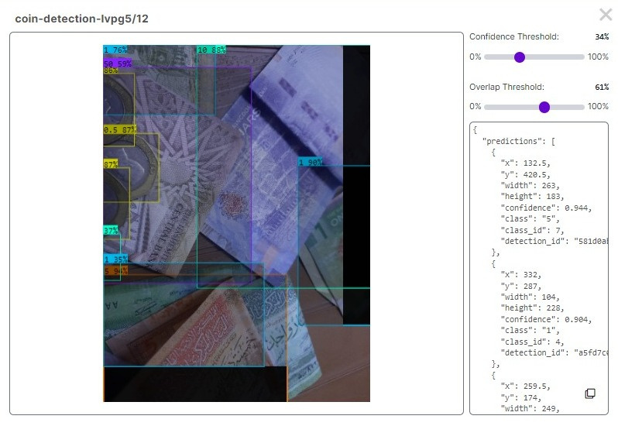
Modeling
V12

Slide 17
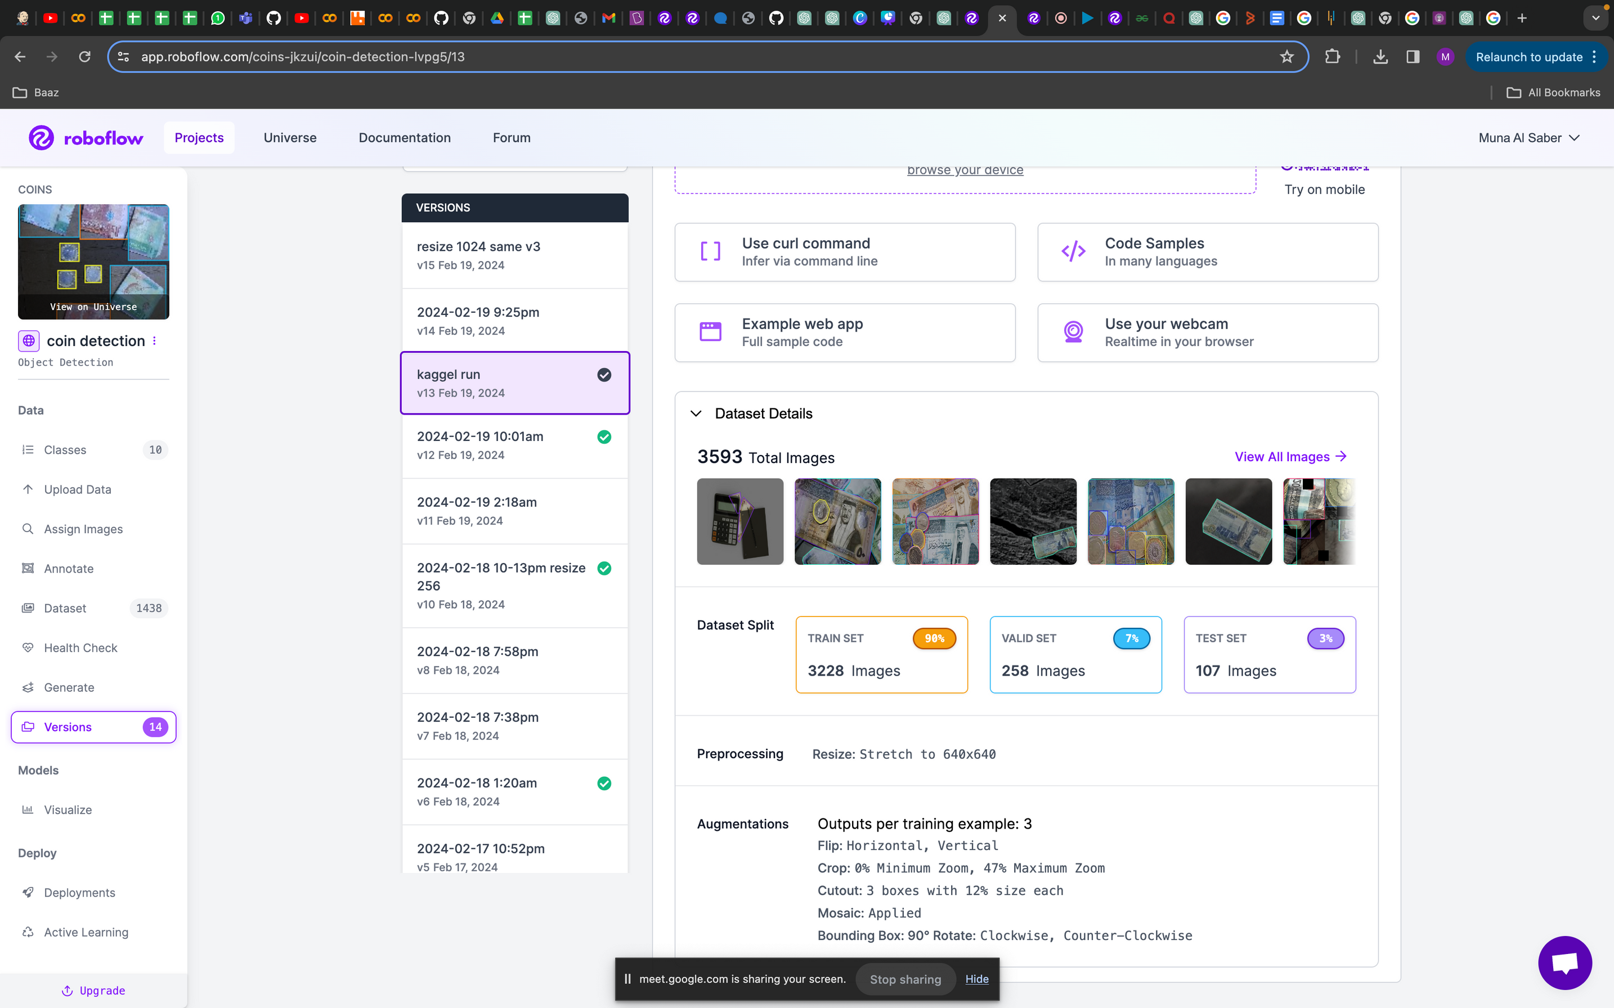
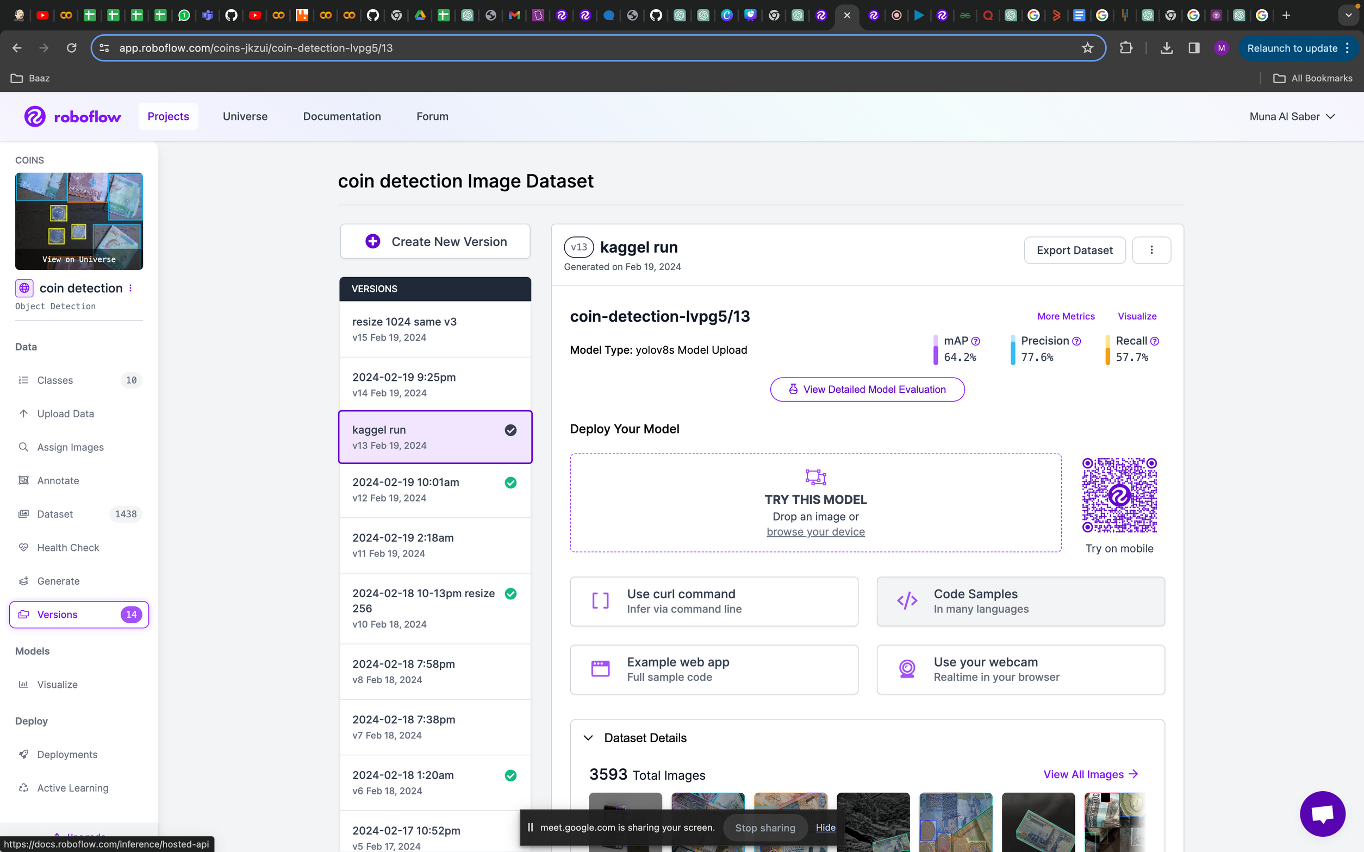
Modeling
v13

Slide 18

Modeling
V14
more dataset
different augmentation

Slide 19
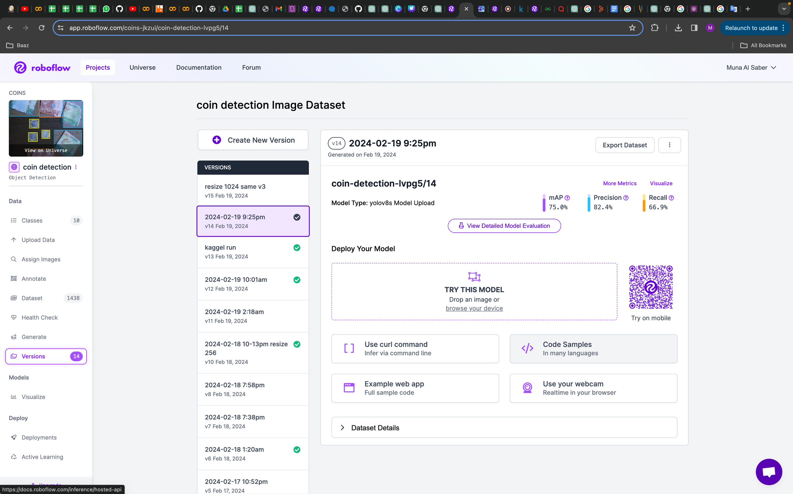
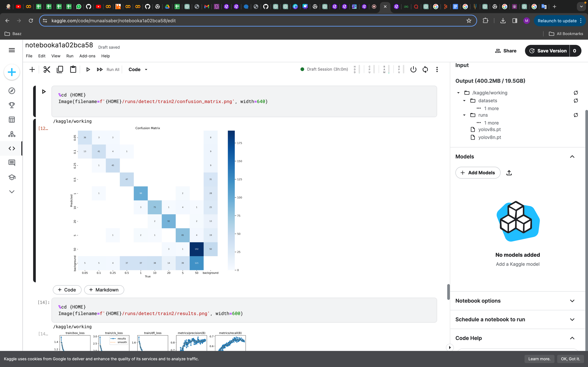
Modeling
V14

Slide 20
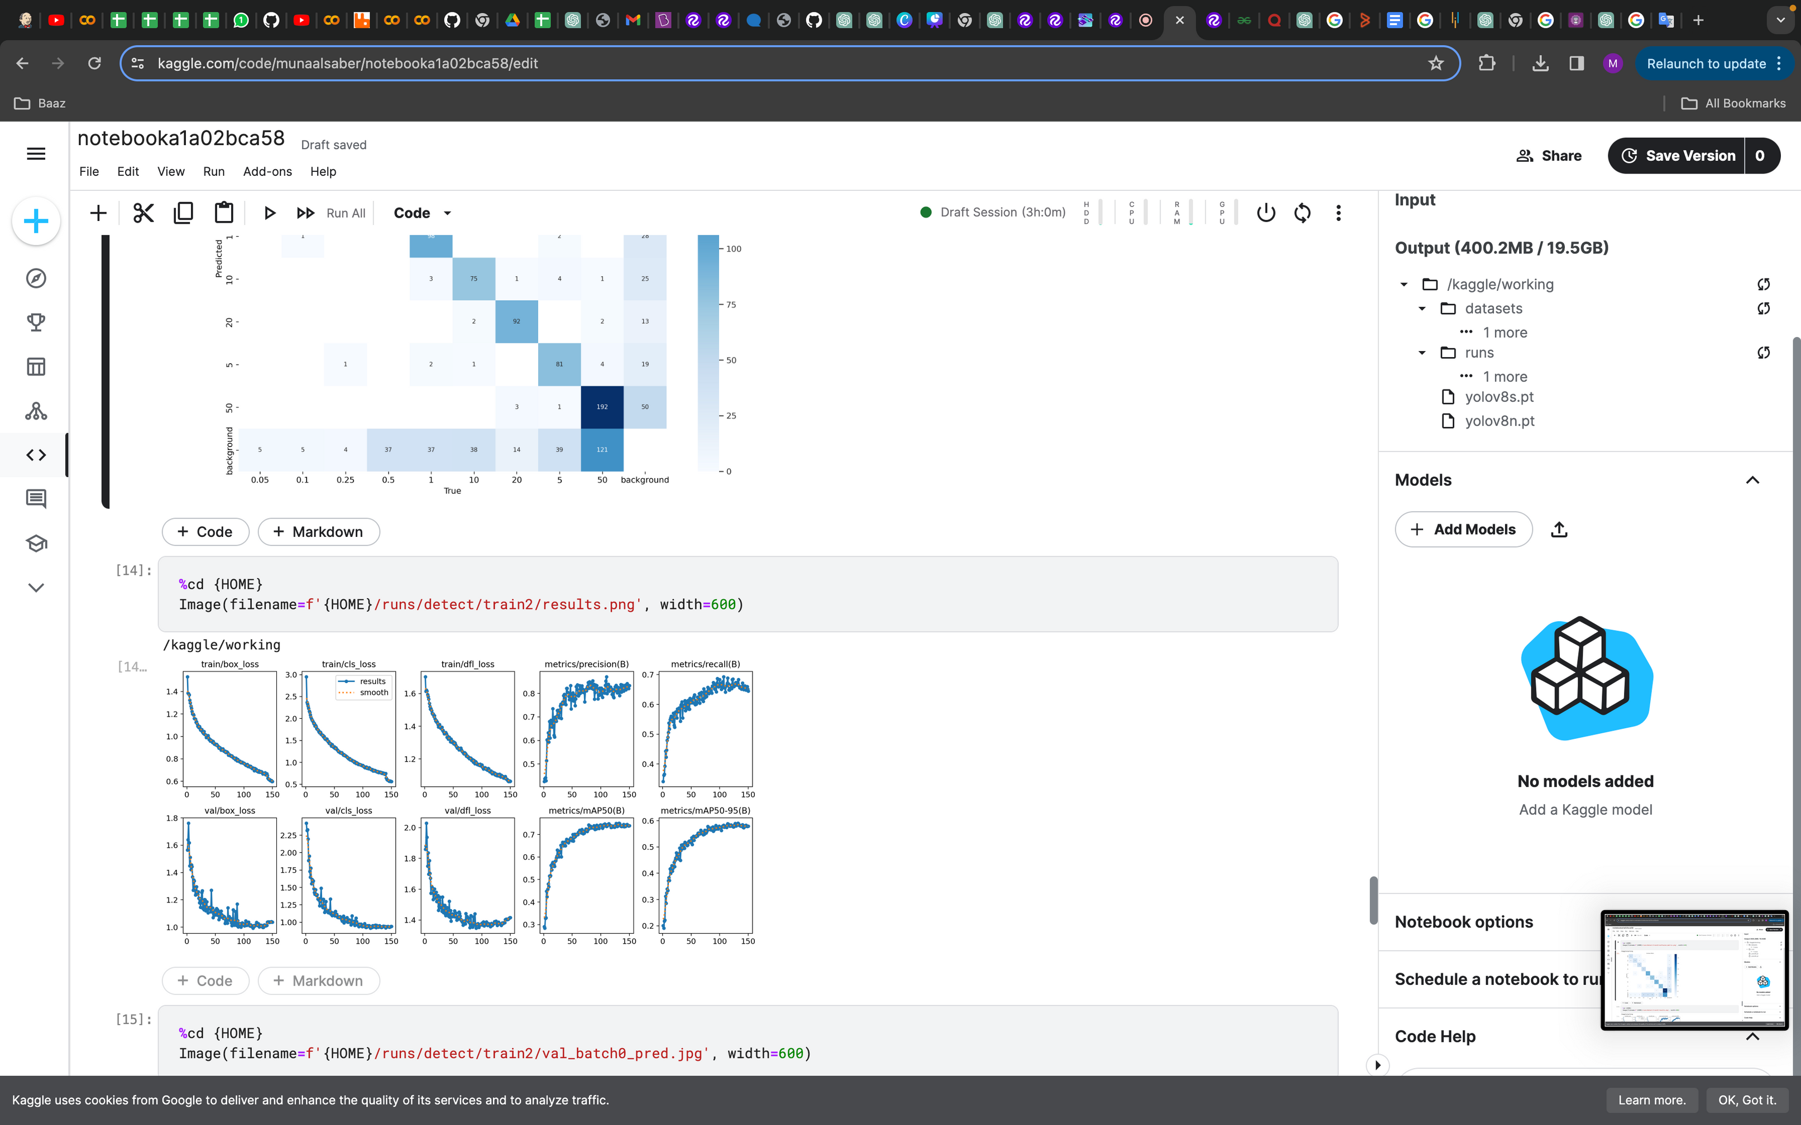
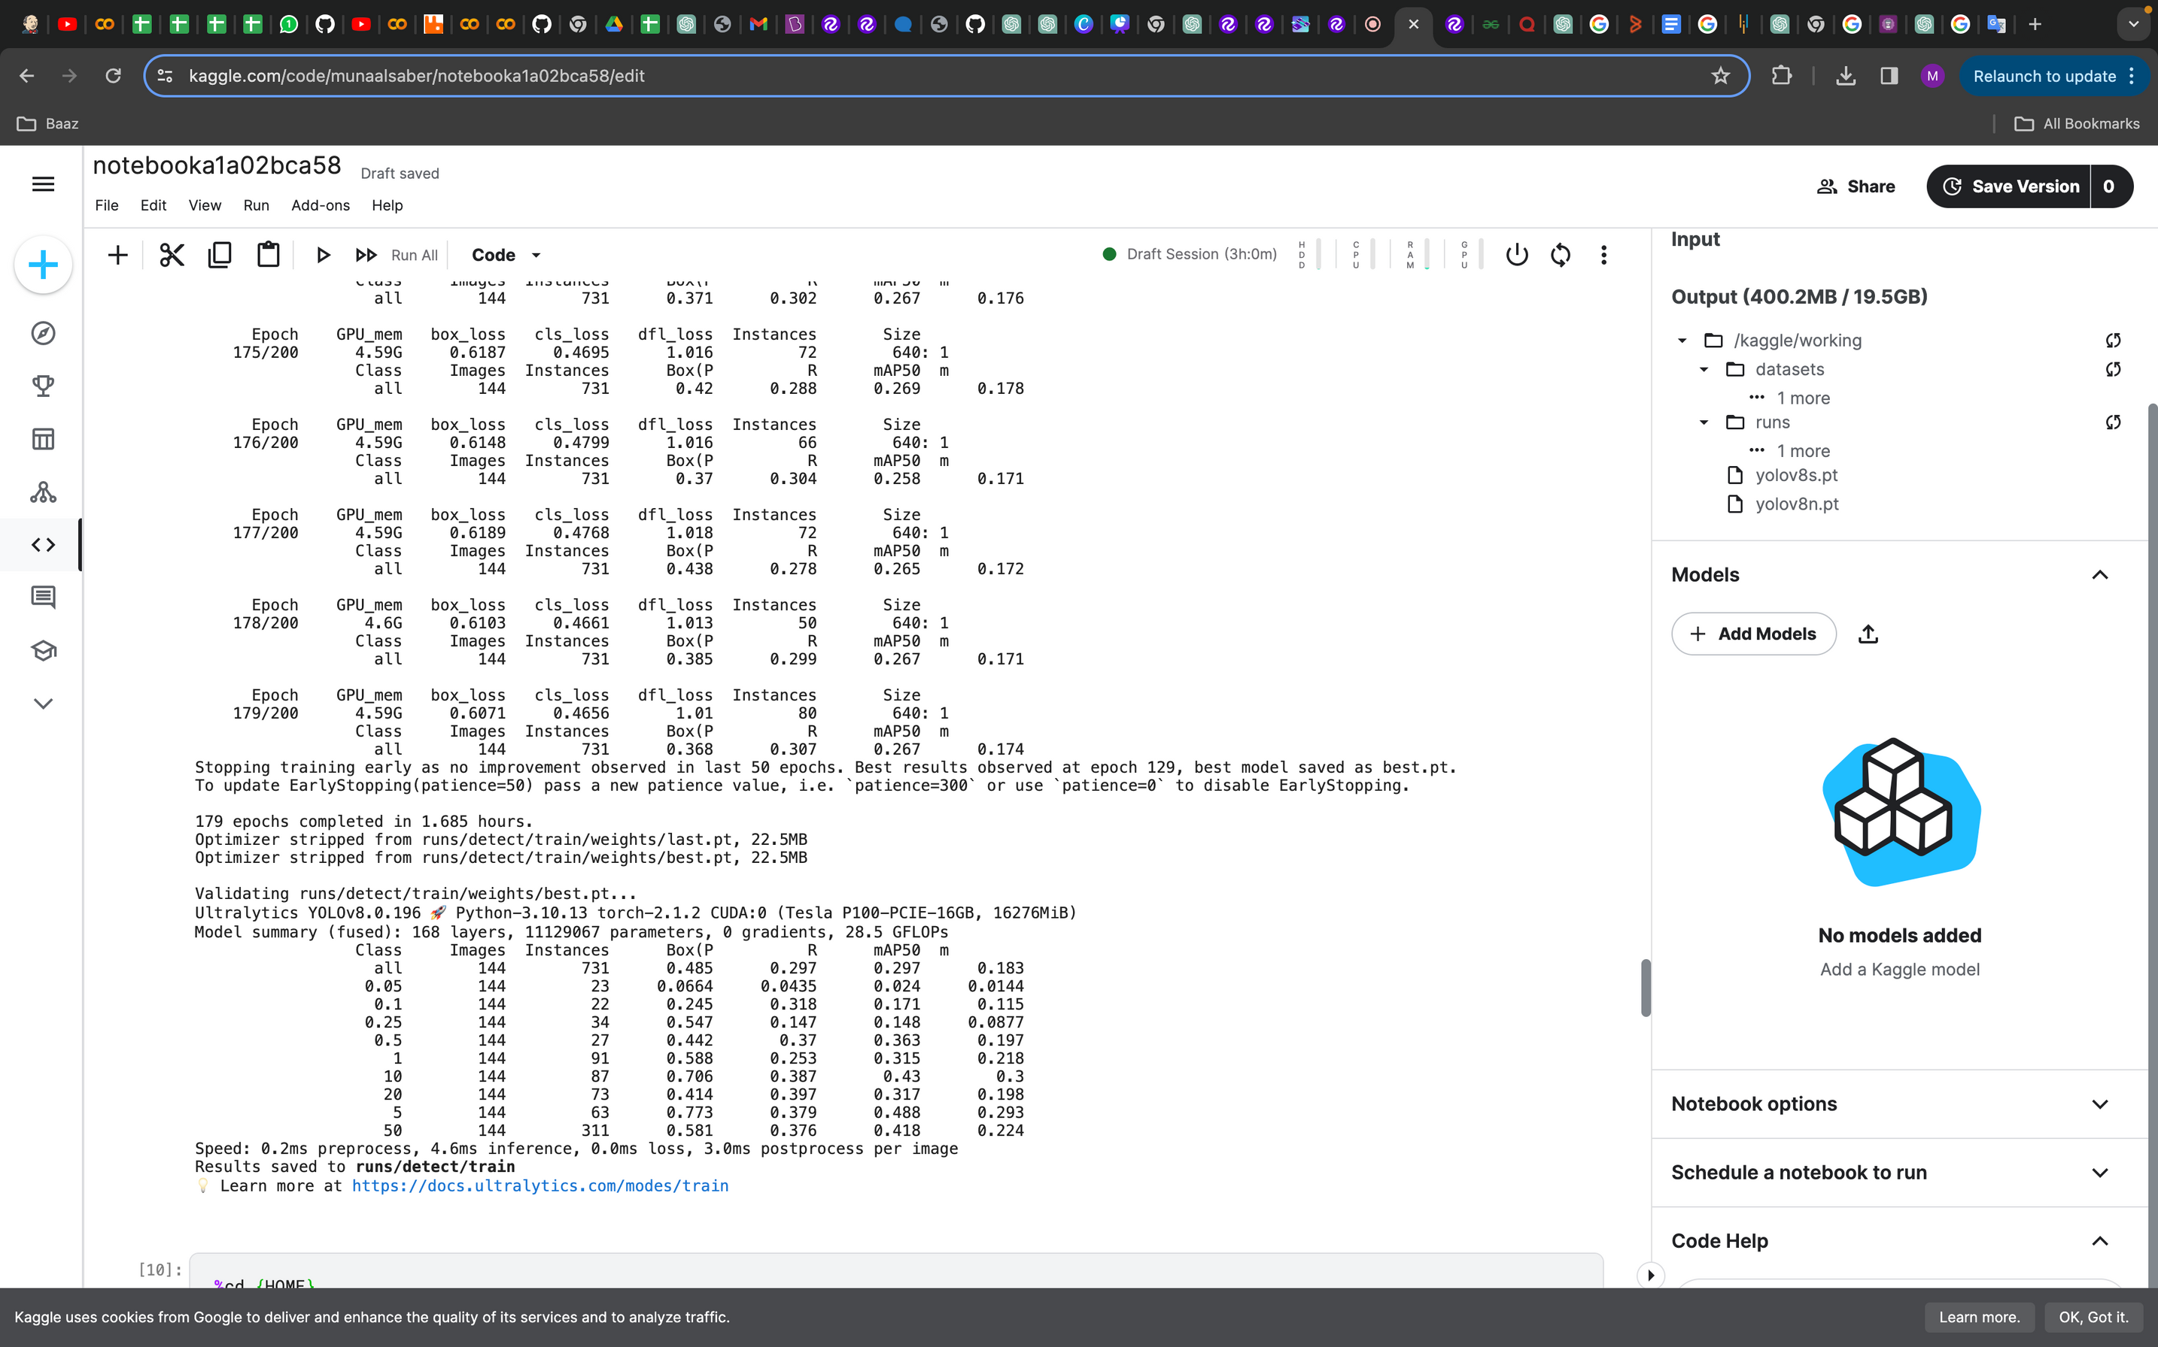
Modeling
V14

Slide 21
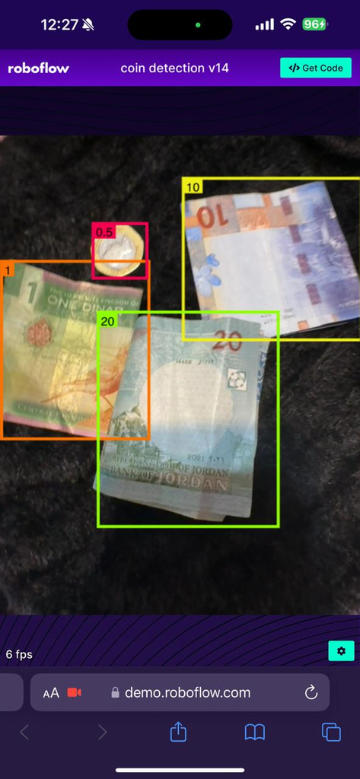
Modeling
V14

Slide 22
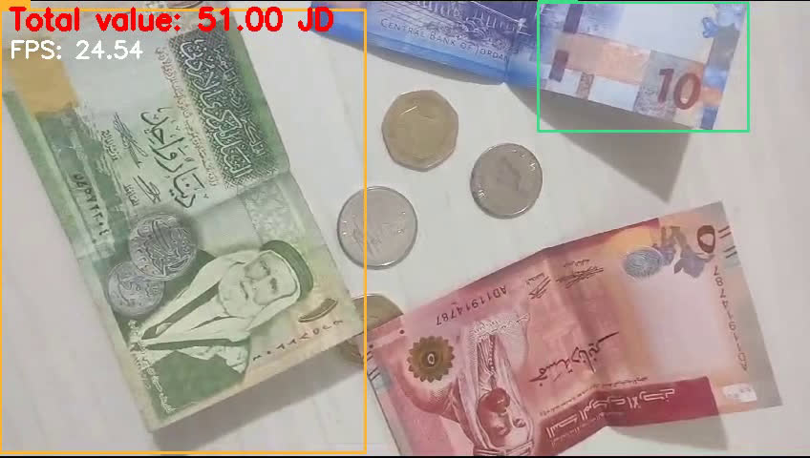
Video
Write your topic or idea

Slide 23
Future Work
Real-time object detection
using segmentation instead of detection

Slide 24












Thank you very much!

Slide 25
Sara Aldmari
Muna Alsaber
Ahmad Qwaqneh
Diala Abdelqader

